Slide 1
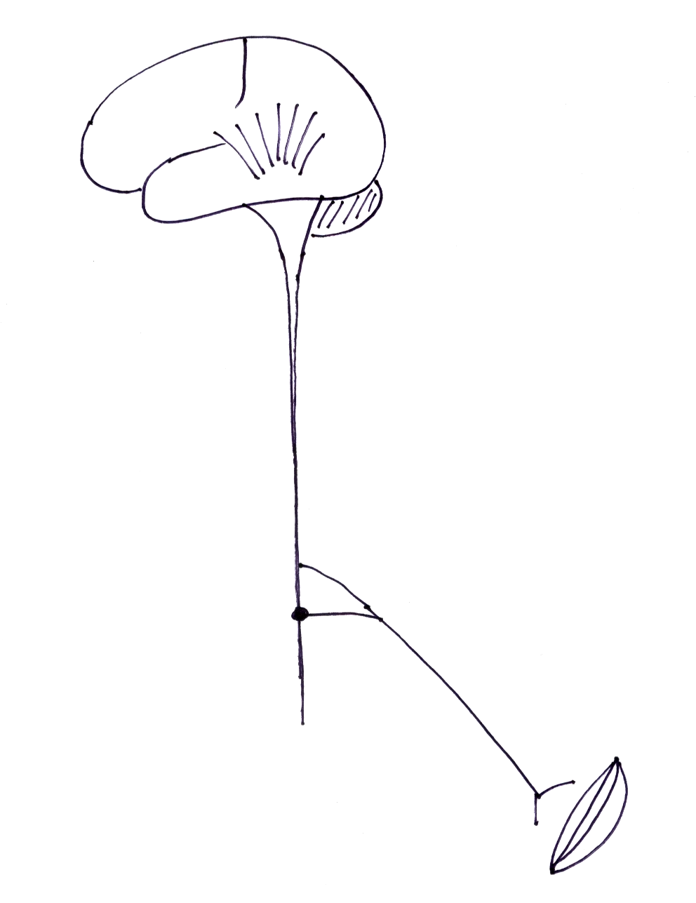
Disorders of muscle
muscle

Slide 2
motor weakness
wasting
proximal
bilateral, symmetrical
tendon reflexes normal/↓
NO sensory loss
muscle

Slide 3
Disorders of muscle (“Myopathy”)
Acquired
Inherited - Genetically determined

Slide 4
Acquired myopathies

Slide 5
Acquired myopathies
inflammatory - ‘myositis’
  pain, tenderness, swelling, warmth
  ↑ ESR, CRP
metabolic/ endocrine

Slide 6
Acquired myopathies
inflammatory - ‘myositis’
  infections - viral, bacterial, parasitic
  autoimmune - polymyositis/ dermatomyositis
metabolic/ endocrine
  hypokalaemia, hypocalcaemia
  Cushing’s, thyroid dis, …..
  alcohol
  drugs - steroids, …..

Slide 7
myositis due to infection
  viral
  staphylococcal, streptococcal
  gas gangrene
  TB
  parasitic - trichinosis, cysticercosis, hydatid disease, toxoplasmosis

Slide 8
Polymyositis
autoimmune inflammatory myopathy
  proximal weakness with wasting
  muscle pain & tenderness - less prominent
  bulbar, respiratory involvement
  arthralgia, Raynaud’s, …
dermatomyositis - PM+ skin changes
PM/DM associated with
  other connective tissue diseases
  internal malignancy

Slide 9
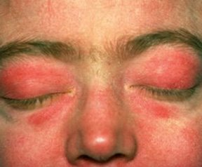

Slide 10
Inherited myopathies

Slide 11
Inherited myopathies
muscular dystrophies
  Duchenne, limb girdle, facio-scapulo-humeral
myotonias
  dystrophia myotonica, myotonia congenita
periodic paralysis - ‘channelopathies’
  hypo/ hyper/ normo - kalaemic
mitochondrial myopathies
inherited metabolic myopathies

Slide 12
Muscular dystrophies
Duchenne muscular dystrophy
  X- linked recessive - males affected
  loss of muscle protein ‘dystrophin’
  onset - 1st few years, disabled by 10 yrs
  proximal weakness, Gower’s sign
  ‘pseudo-hypertrophy’ of calf muscles
  cardiac muscle involvement
  death due to aspiration pneumonia

Slide 13
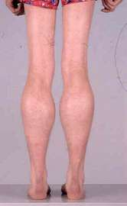

Slide 14
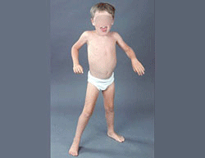

Slide 16
Dystrophia myotonica
myotonia
‘distal’ weakness
frontal balding, ptosis, wasting- face, sternomastoids
cardiac muscle involvement
endocrine - diabetes, hypogonadism
AD, trinucleotide repeat expansion
onset - 20-40 yrs

Slide 17
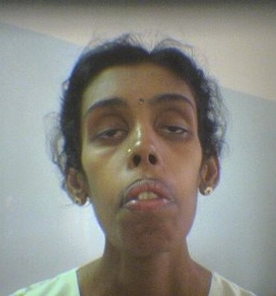

Slide 18
Periodic paralysis
ion channel disorders - ‘channelopathies’
onset - childhood, young adults
recurrent episodes of generalised weakness
precipitated by - heavy CHO meal, exercise
hypokalaemic -
hyperkalaemic -
normokalaemic -

Slide 19
Investigation of muscle disease

Slide 20
Investigation of muscle disease
muscle enzymes - CPK, aldolase
  ↑ ↑ in PM/DM, Duchenne
EMG
  myopathy, myotonia
muscle biopsy
genetic testing
other - autoimmune, inflammatory, infection, …

Slide 21
Treatment
specific treatment
  PM/DM - steroids, immunosuppressants
  myotonia - phenytoin
physiotherapy
genetic counselling

Slide 22
Remember
‘proximal myopathy’
Acquired/ Inherited
  inflammatory, metabolic
  Duchenne
  dystrophia myotonica
  periodic paralysis
Ix - CPK, EMG, biopsy

